Slide 1
High Altitude Balloons and the Search for Exoplanets:
The PICTURE-C Observatory
Thad Potter
10/31/2024

Slide 2
Exoplanets
Why do we want to find exoplanets?
  Understand the Earth and Solar System Better
  See how other systems formed, how rare is our solar system?
  Potentially find habitable/ inhabited planets
  Technology development
  Exoplanets are cool

Slide 3
Exoplanets
5800 confirmed exoplanets
7200 candidates
Only 68 have been directly imaged!
Need light from the planet to learn more information
  Atmosphere Comp.
  Biomarkers
  Direct
  Reflected
  Transmitted

Slide 4
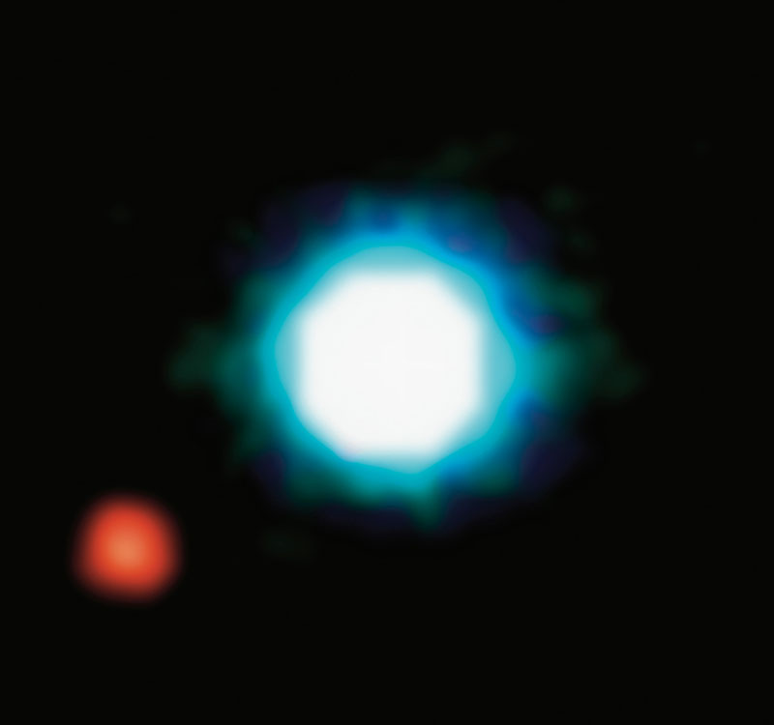
ESO Paranal Observatory

Slide 5


Slide 6
Why are so few directly imaged?
Try to take a picture of a firefly…
From 40 miles away…
While it’s 1 foot away from a search light

Slide 7
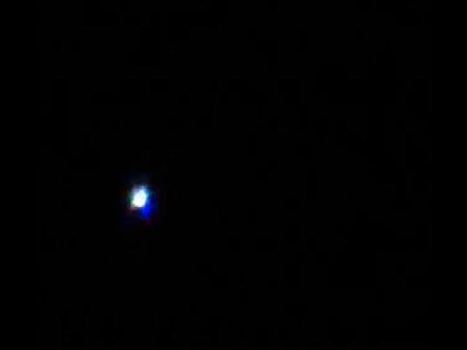
Ground Telescopes?
Bautch 2021
Sirius

Slide 8
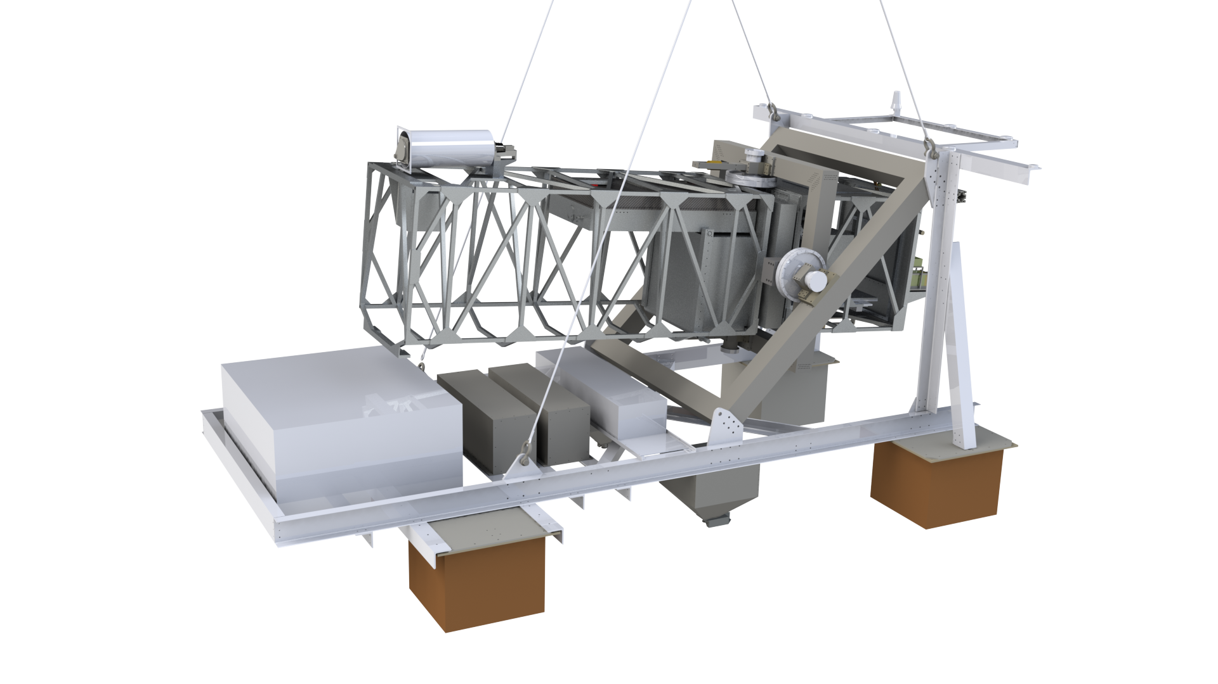


PICTURE-C
Test Flight 1:
  September, 2019
Science Flight 2:
  September, 2020…
  2021…
  2022!
PICTURE-D
  2025!

Slide 9
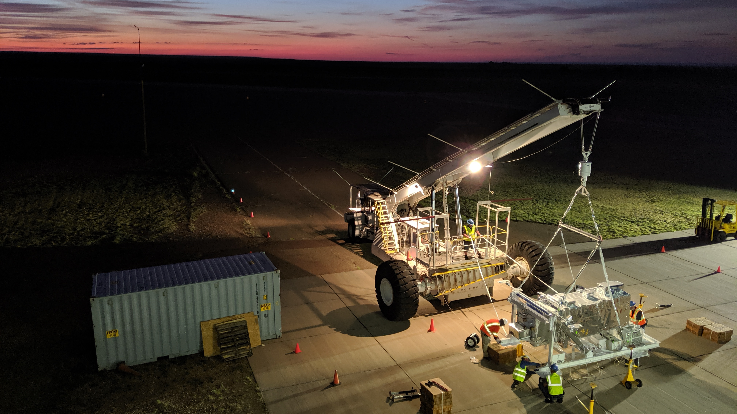
Ft. Sumner, NM
September 28, 2019
5AM Roll-Out

Slide 10
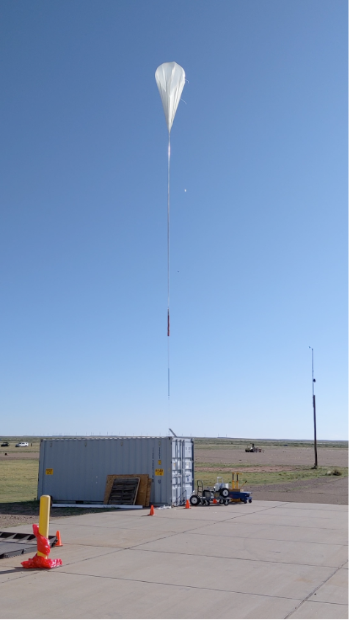
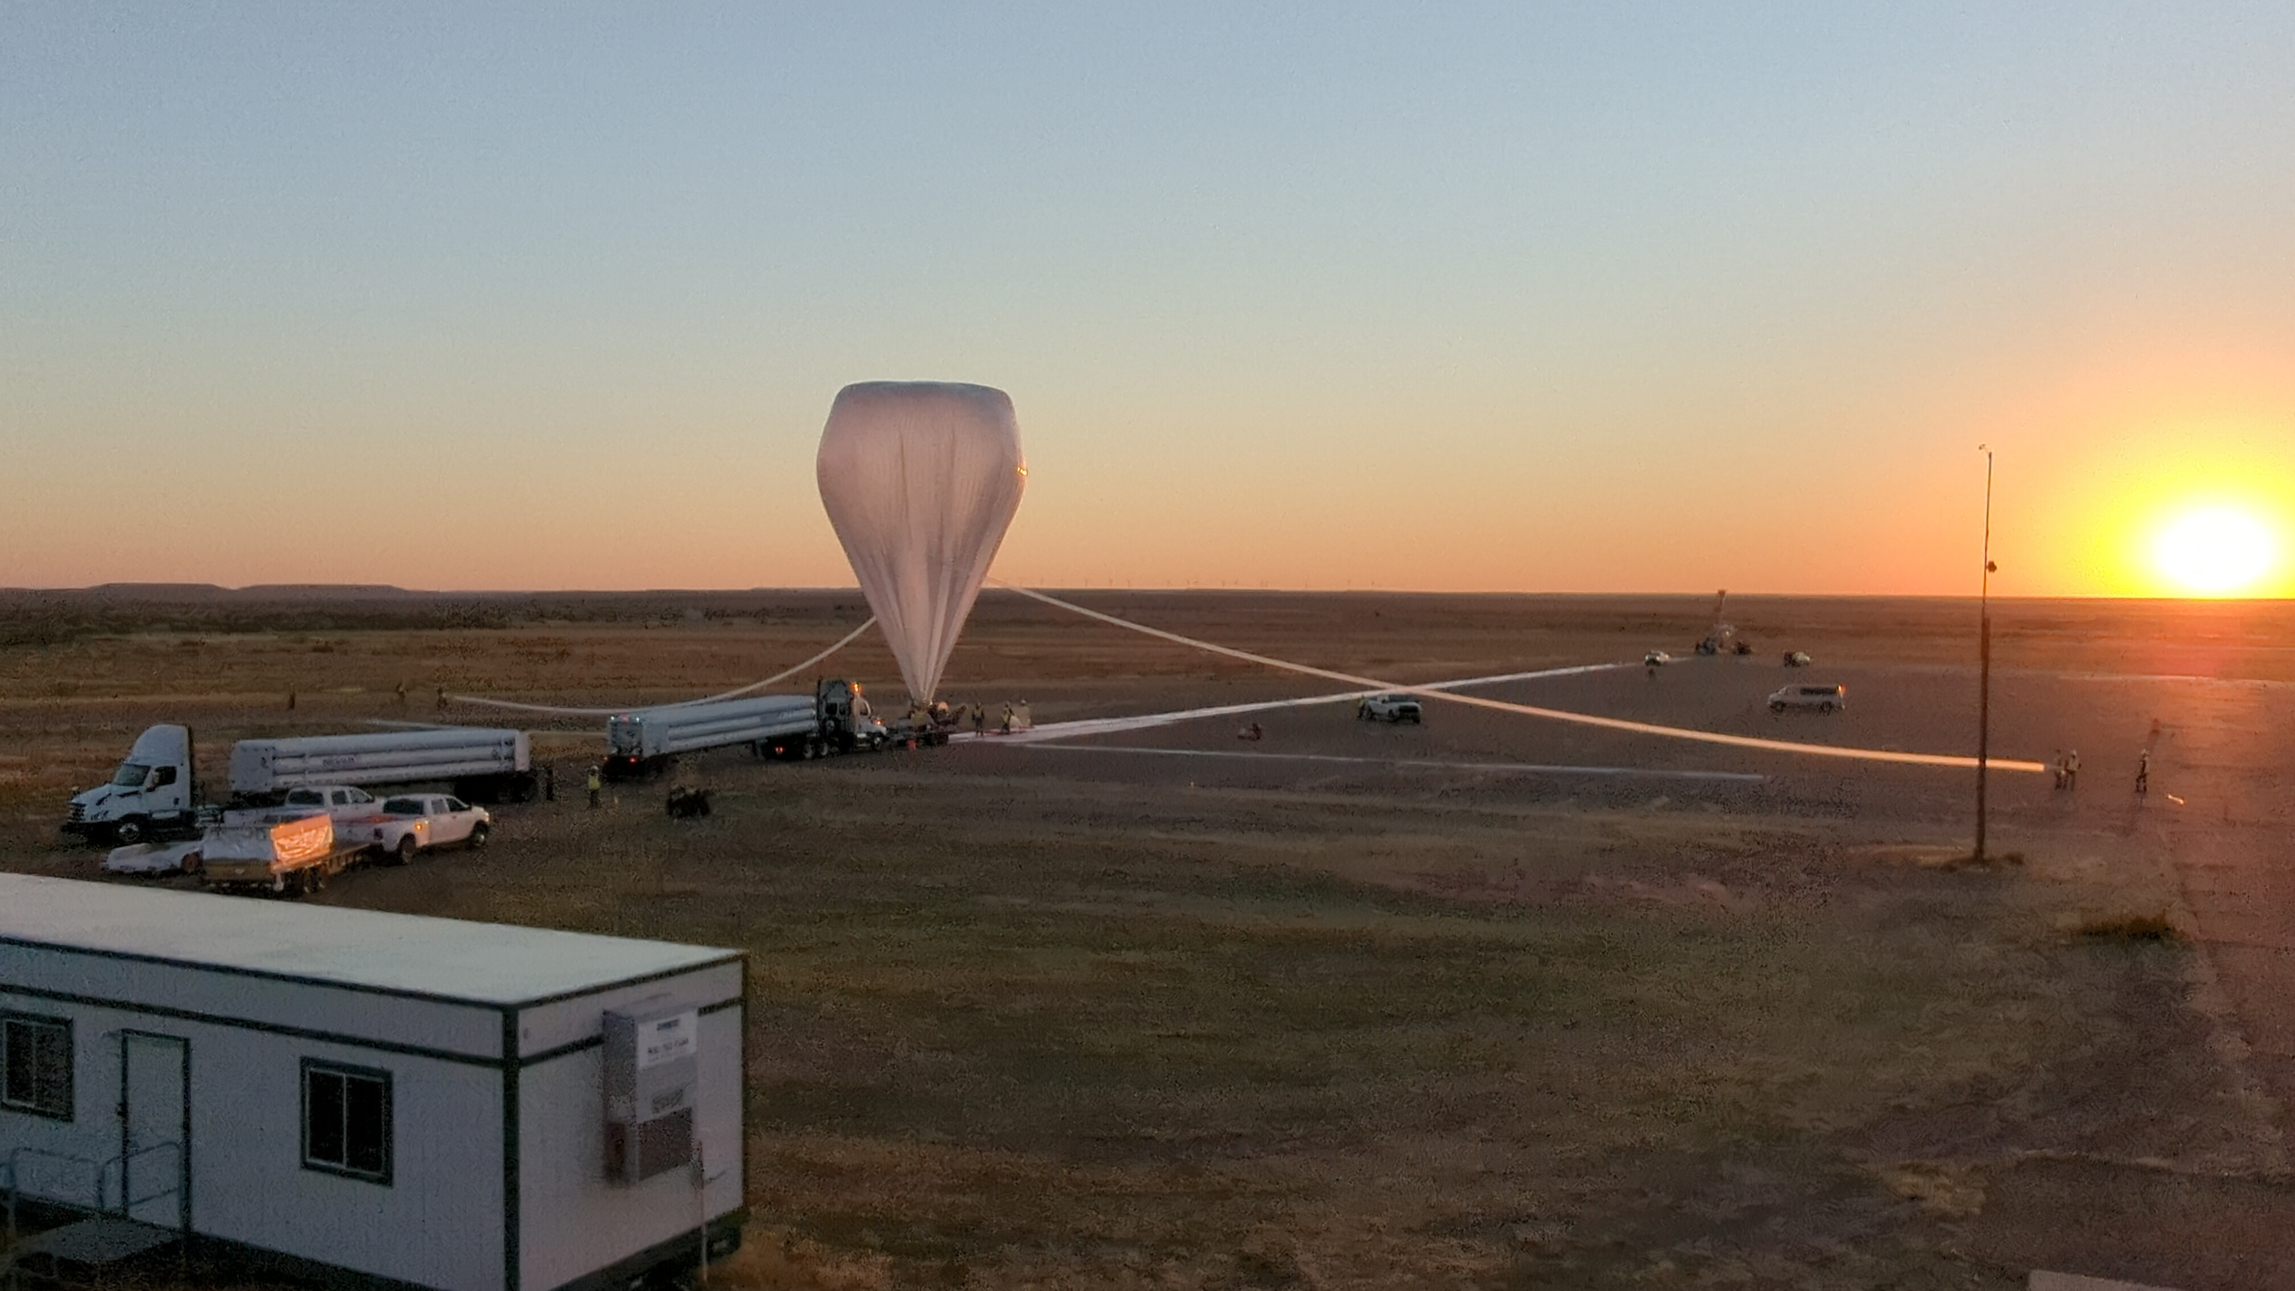

Slide 11
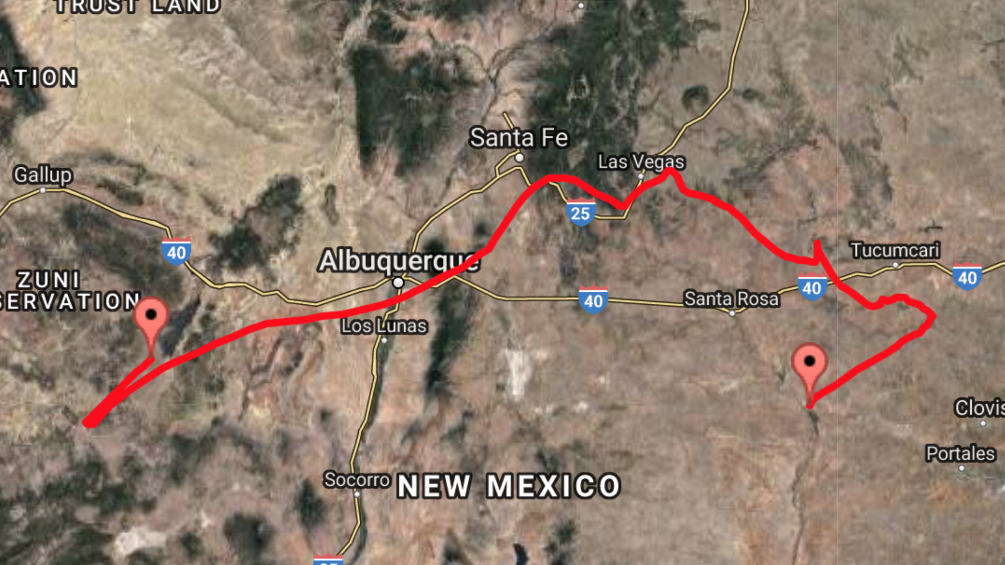
20 Hour flight
9 Targets
220 Miles
Fort Sumner

Slide 12
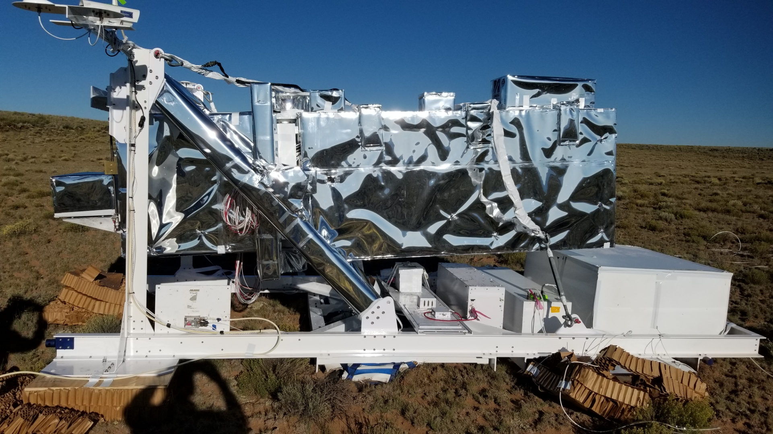

Slide 13
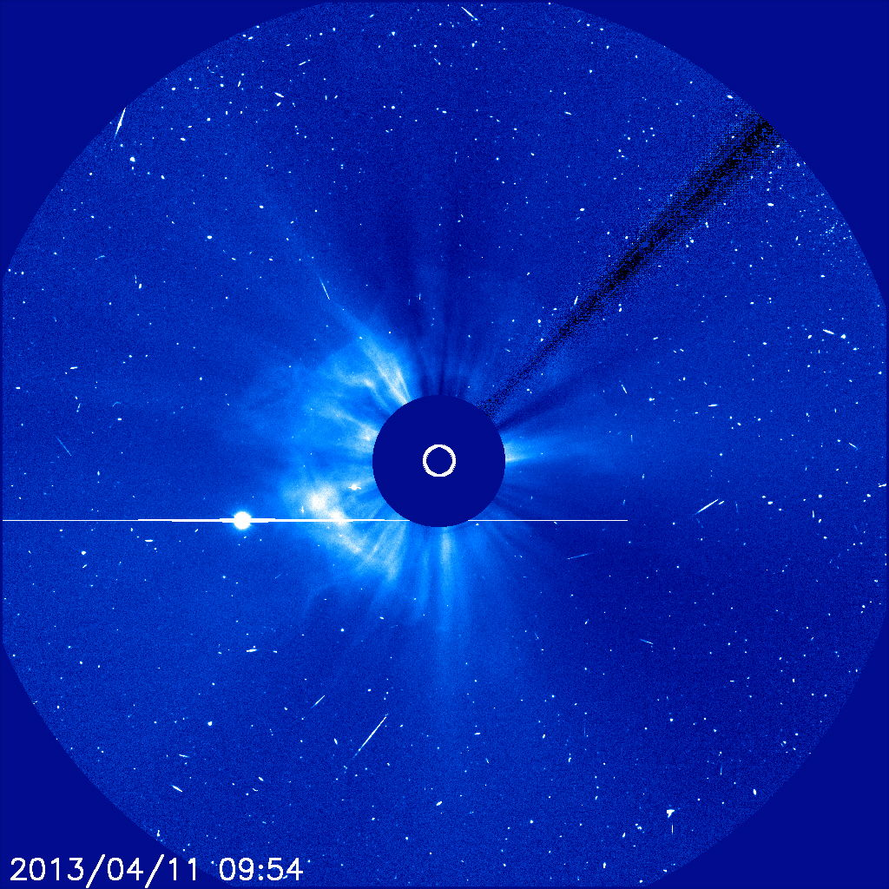
What is the goal of PICTURE?
Not taking pictures of the firefly…
But we can see dust around the spotlight
COR2

Slide 14
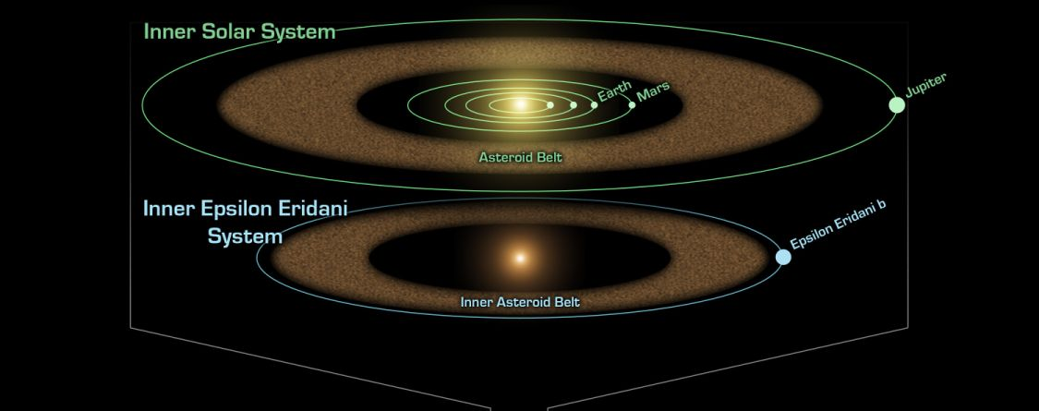
Epsilon Eridani b?
3.2 pc = 10.4 ly
Image credit: NASA/JPL-Caltech
Approx. PICTURE-C FOV

Slide 15
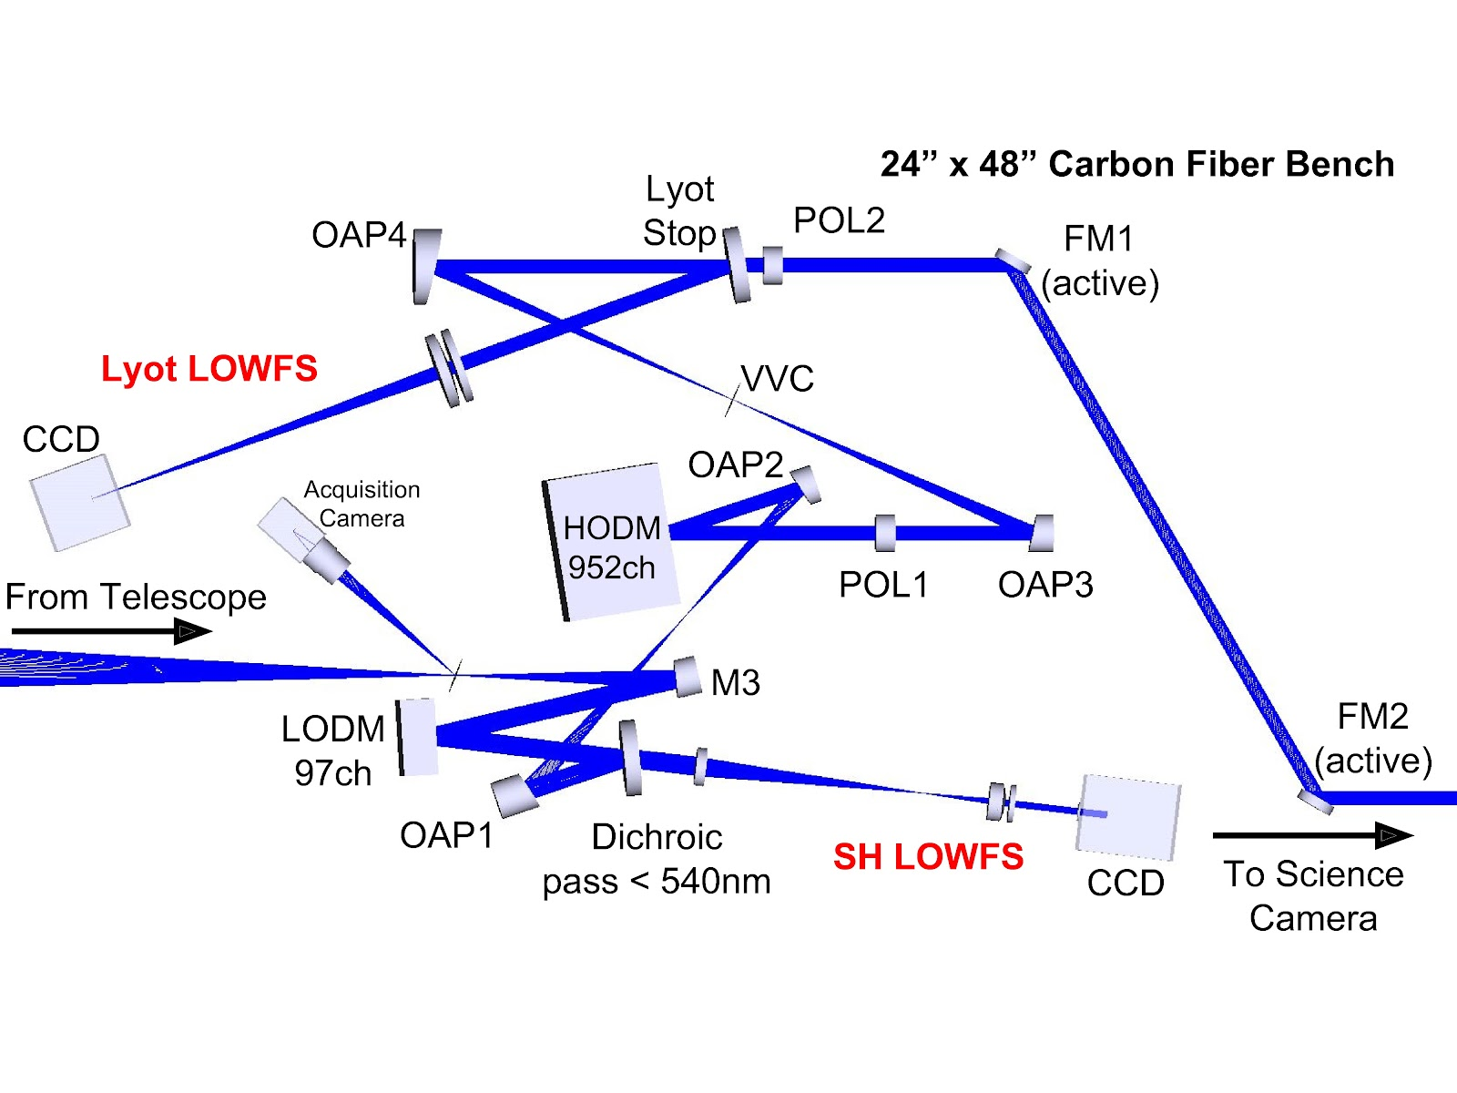
How does PICTURE Work?

Slide 16
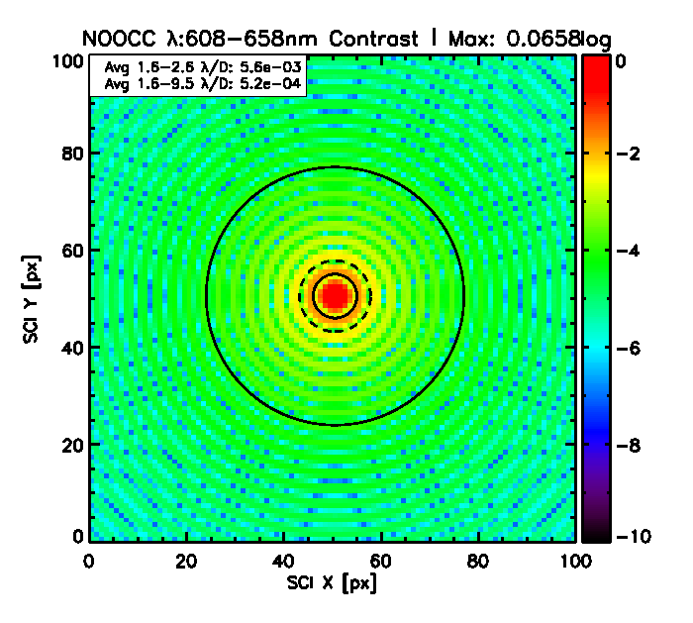
What can PICTURE do?
Need to
Get here

Slide 17
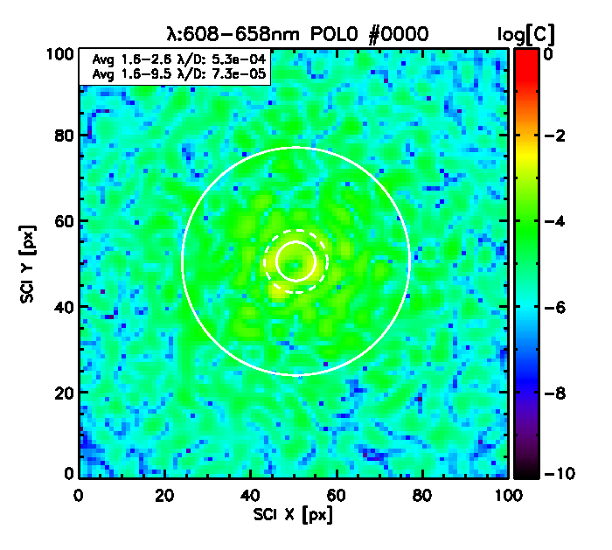
What can PICTURE do?
Need to
Get here

Slide 18
What can PICTURE do?
Need to
Get here

Slide 19
How does PICTURE Work?

Slide 20
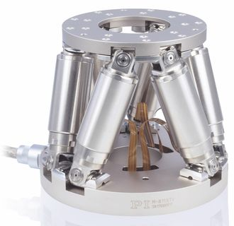
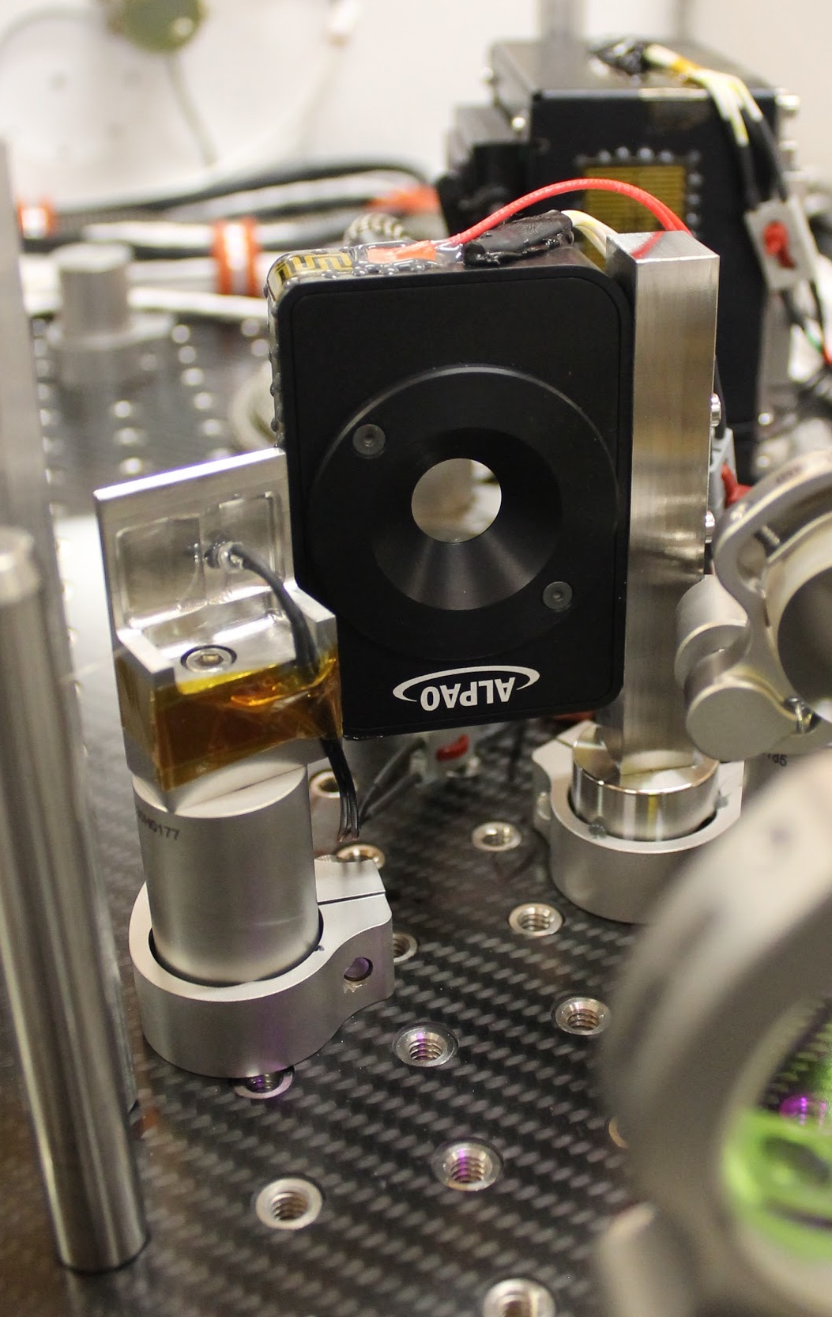
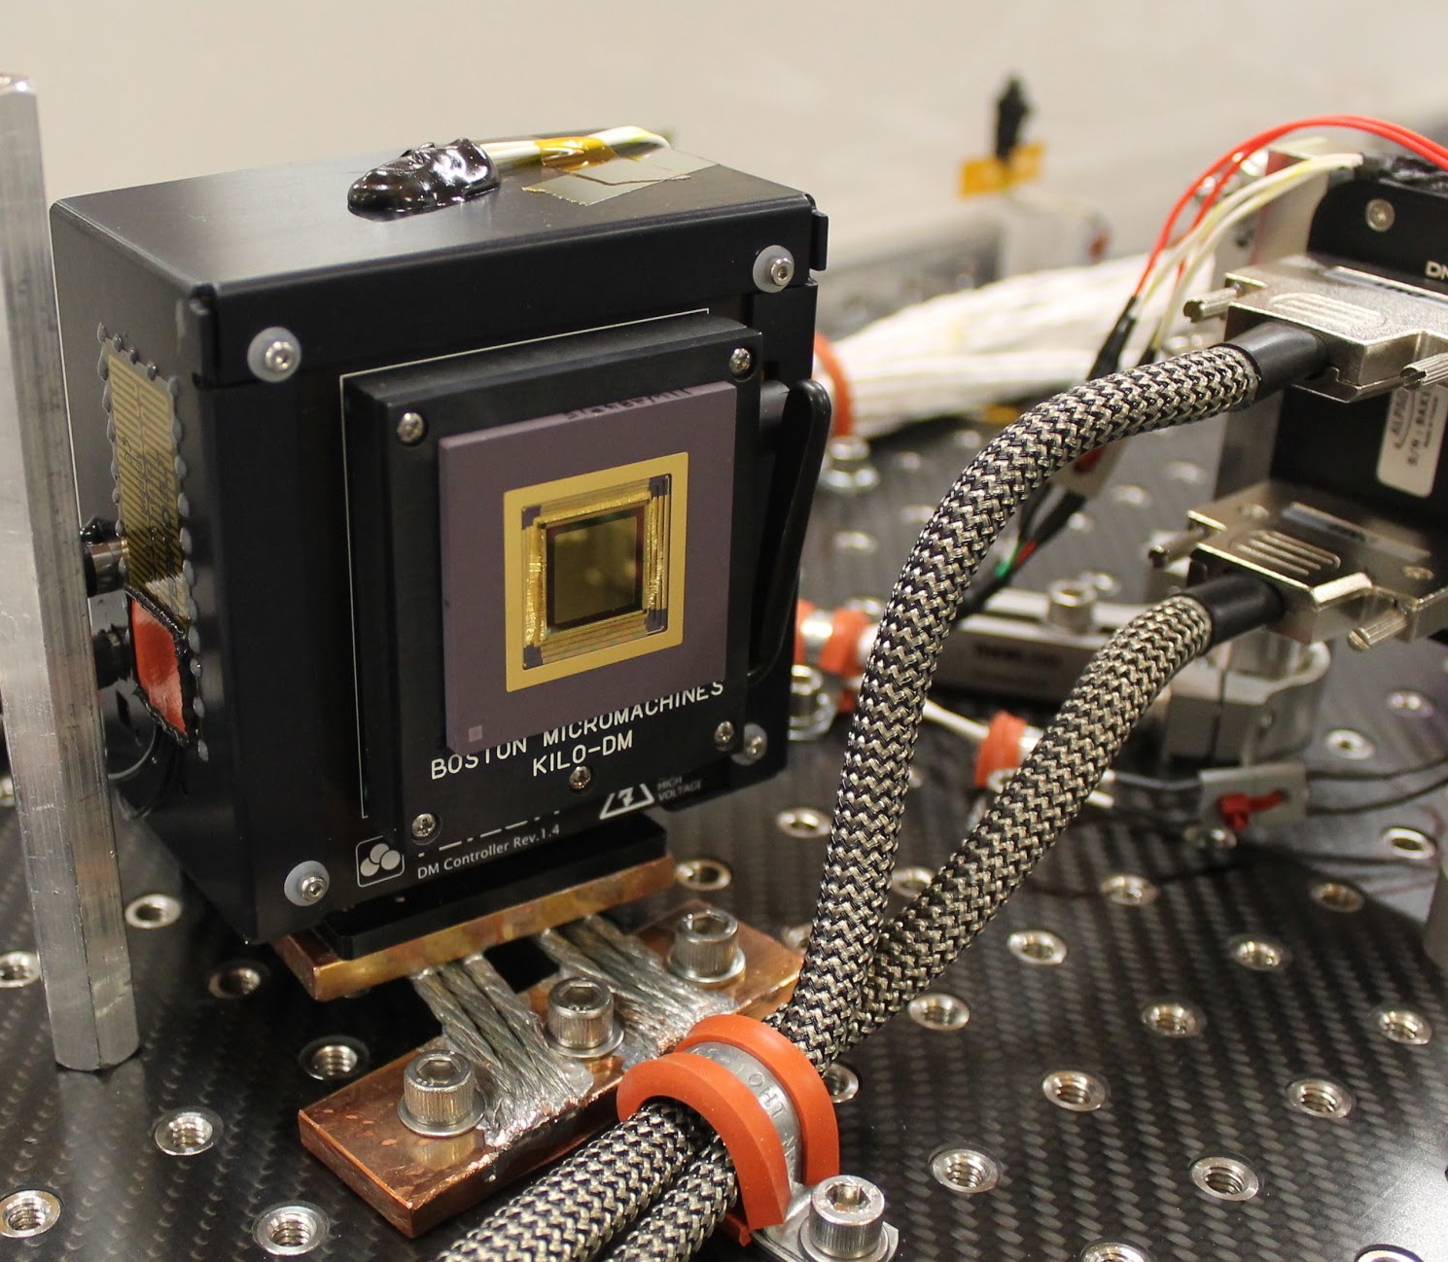
How does PICTURE work?
Hexapod
  Large Errors
ALPAO DM
  Control for fast errors
BMC DM
  High Contrast!
ALPAO: 97ch LODM
BMC: 1020ch HODM + Mini Controller

Slide 21
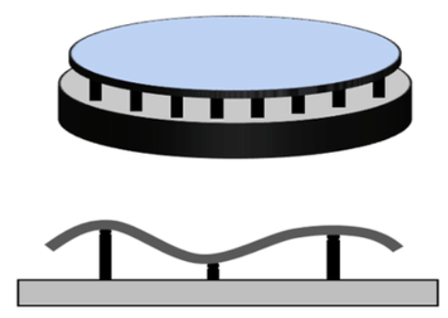
Deformable Mirrors

Slide 22
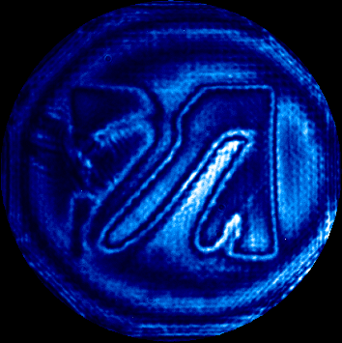
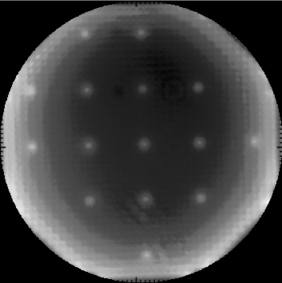
Kuravi Hewawasam, UML

Slide 23
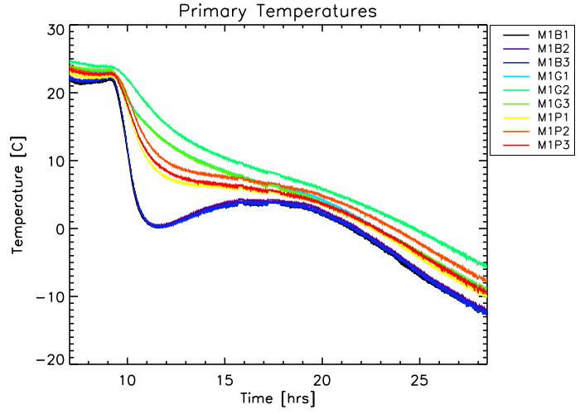
Temperature Drift
Very sensitive to alignment and distortion
Its cold up there!

Slide 24
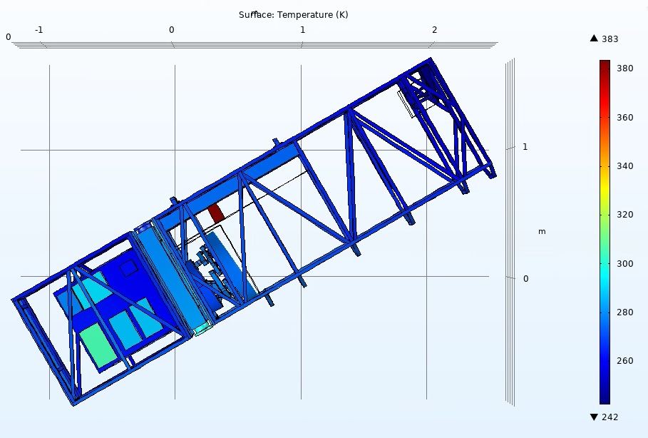
Thermal and mechanical modeling
Temperature over Time
Deformation of the Telescope
Deformation of the Mirrors
Image Quality over Time

Slide 25
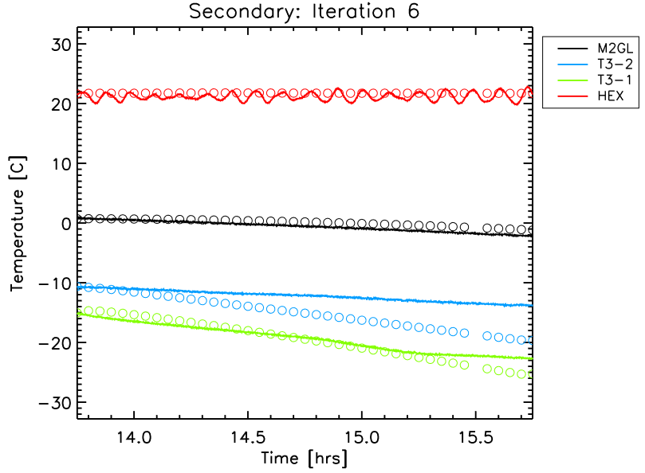
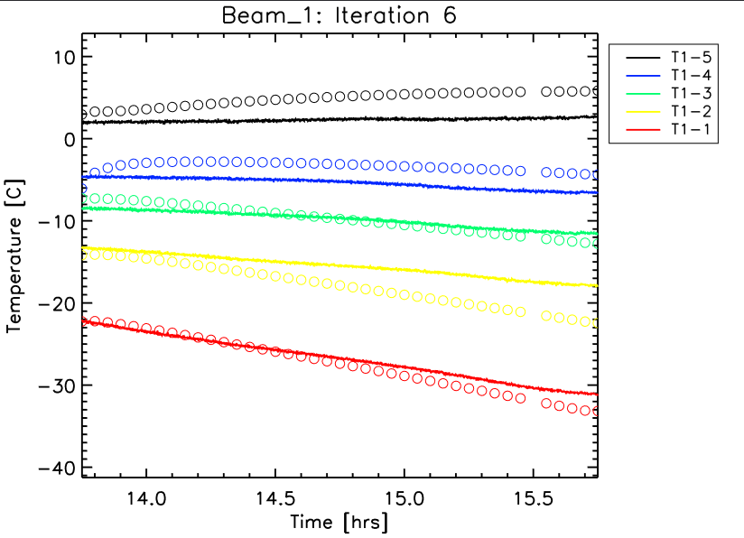
Temperature over time

Slide 26
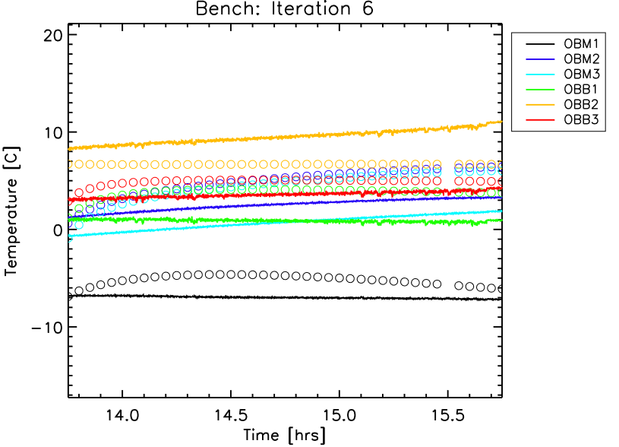
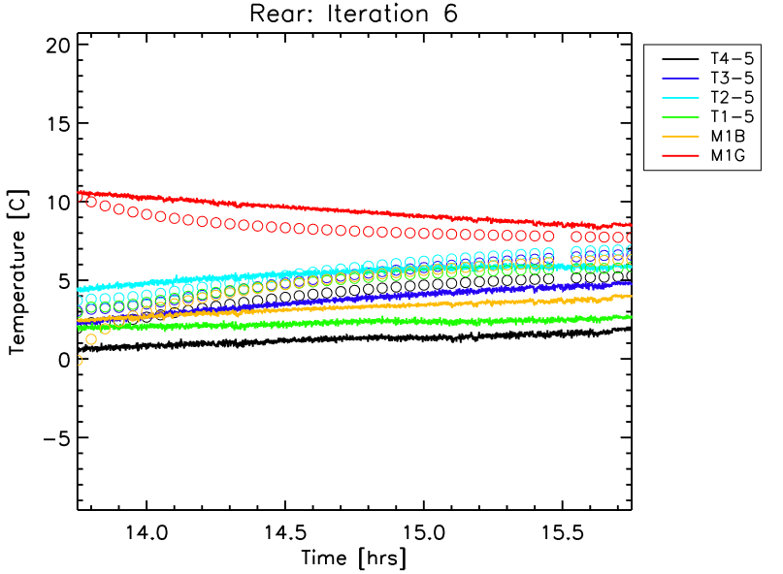
Temperature over time

Slide 27
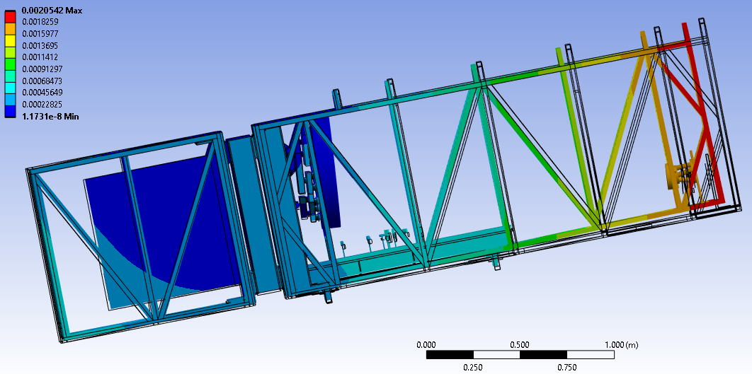
Deformation of the Telescope

Slide 28
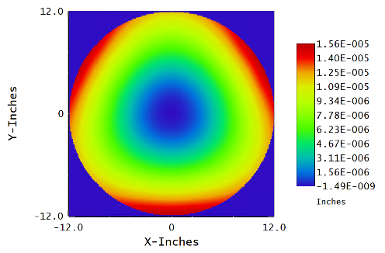
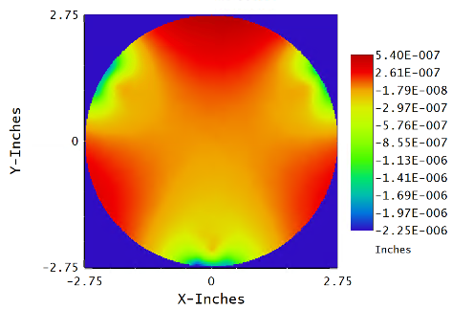
Deformation of the Optics

Slide 29
Image quality over time

Slide 30
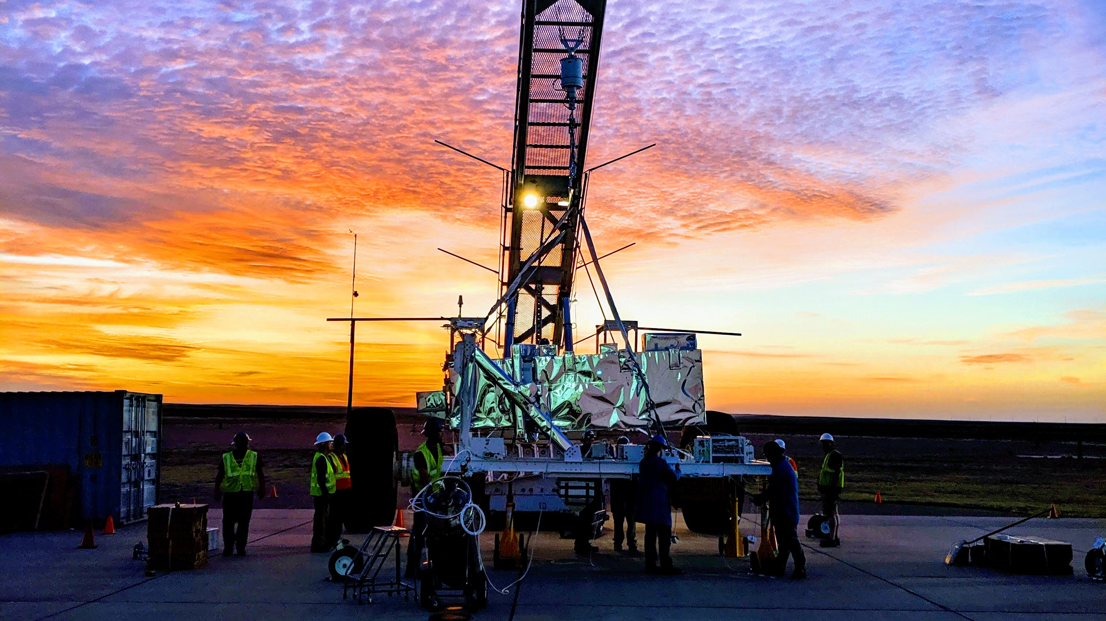
Thank you!

