Slide 1
Town Hall
September 6, 2022

Slide 2
A Vision for UMass Lowell: Interconnected priorities
An inclusive, vibrant Public R1 University in a Gateway City
  Student Recruitment and Success
    Paid career experiences and student Return on Investment
    Student mental health education, tools & resources
  Our transition to R1 status
    Importance of reputation
    Offering our students the highest level of discovery and impact
  Leveraging our community as a strength
    Diverse cultural opportunities
    Economic development and broad partnering opportunities
  A diverse, welcoming and inclusive campus

Slide 3

Strategic Planning
PROPOSED PROCESS & TIMELINE
Framing the Conversation | Early September
Stakeholder survey | September – Early October
Benchmarking & background information | August – November (ongoing)
Establish & launch committee work | October
Assemble & present draft plan | Early December
Solicit feedback on draft plan | December
Revise & publish | Winter Break
Present final plan | Spring Semester

Slide 4
enrollment & Budget impact
Sept. 7
10,322
4799
2015

Slide 5
FY23 Revenues
Financial Aid and Scholarships,
-$67M
(Up +)

Slide 6
FY23 Expenses

Slide 7
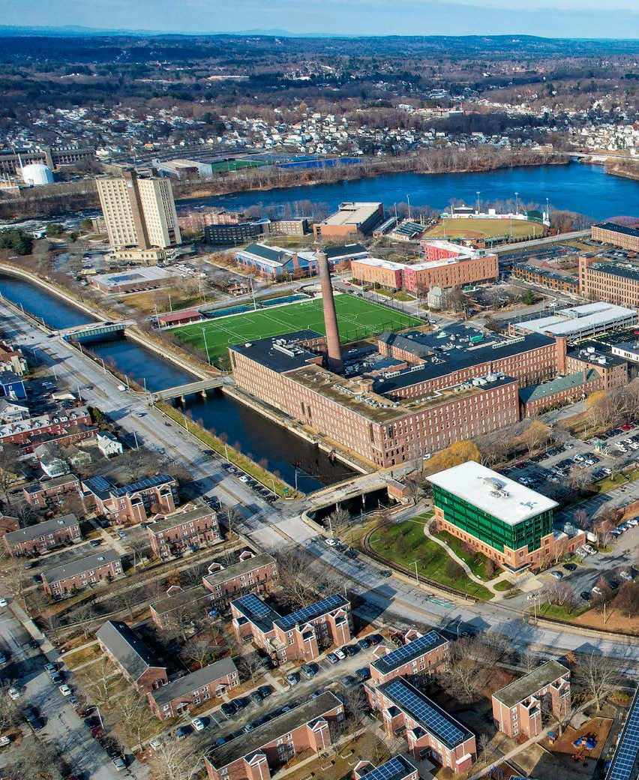
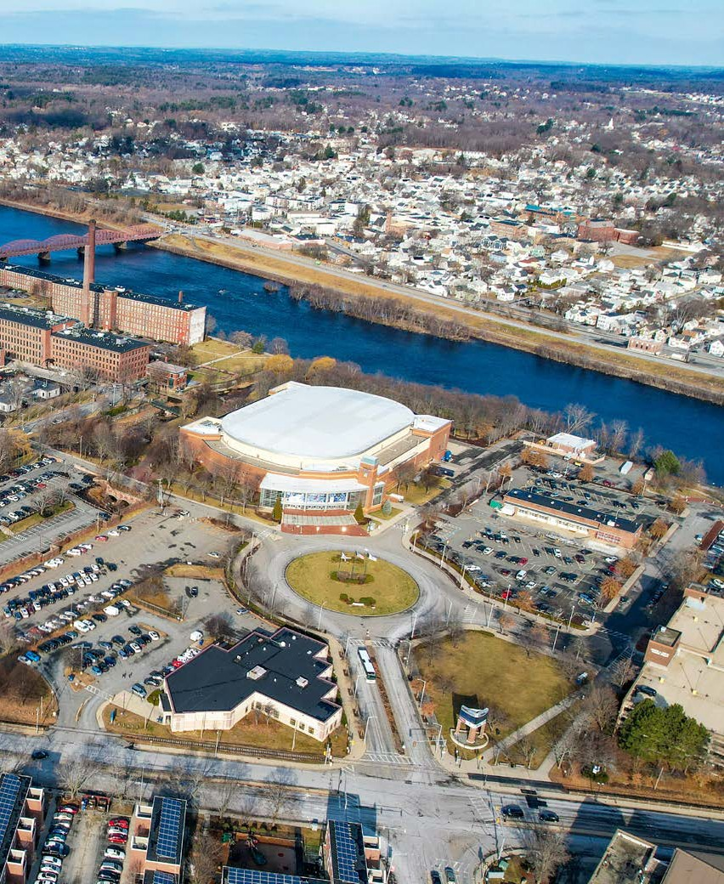
Campus Updates: East Campus
10 ACRES
APPROX. LAND AREA
1
1,079,040 SF
2
3
4
POTENTIAL DEVELOPMENT
5
 | NAME | APPROX. LAND AREA (SF) | APPROX. LAND AREA (ACRES) | POTENTIAL DEVELOPMENT (SF) | CURRENT USE | OZ
① | AIKEN AVENUE | 65,734 | 1.90 | 131,468 | SURFACE PARKING | NO
② | CABOT STREET | 21,900 | 0.63 | 43,800 | SURFACE PARKING | NO
③ | SUFFOLK STREET | 64,600 | 1.87 | 129,200 | SURFACE PARKING, SMALL RESEARCH BUILDING | NO
④ | TSONGAS NORTH | 70,900 | 2.05 | 283,600 | LANDSCAPED OPEN SPACE | YES
⑤ | TSONGAS EAST | 122,743 | 3.55 | 490,972 | SURFACE PARKING, SMALL WAREHOUSE BUILDING | YES
 | TOTAL | 345,877 | 10.01 | 1,079,040
Notes:
AB
Equivalent to GSF of Fox, Olney, Olsen, University Crossing, and the Tsongas Center combined.

Slide 8
Campus Updates: Possible East Campus Future

Slide 9

September in the City
Kicking off community engagement
KICKOFF SEPTEMBER 8TH 4-6 P.M.
JFK PLAZA (CITY HALL)
Celebration & Block Party
Raffles for local gift certificates, chancellor’s parking space & more!

Slide 10
Open discussion

