Slide 1
Post Completion OPT
Job Search Workshop
The Career & Co-op Center at the University of Massachusetts Lowell
978-934-2355 | career.uml.edu
450 University Crossing | 105 O’Leary Library

Slide 2
Workshop Agenda
Being proactive (not only reactive)
Online job search
Networking
How we can help

Slide 3
Being proactive
This means NETWORKING!
How much time should you spend on the job search?
It’s OK to be anxious – as long as it motivates you to take action

Slide 4
The Online Job Search
CareerLINK
Indeed.com/Simplyhired.com
Specialty job boards (those on our website and others)
Example: ISPE (International Society for Pharmaceutical Engineering)

Slide 5

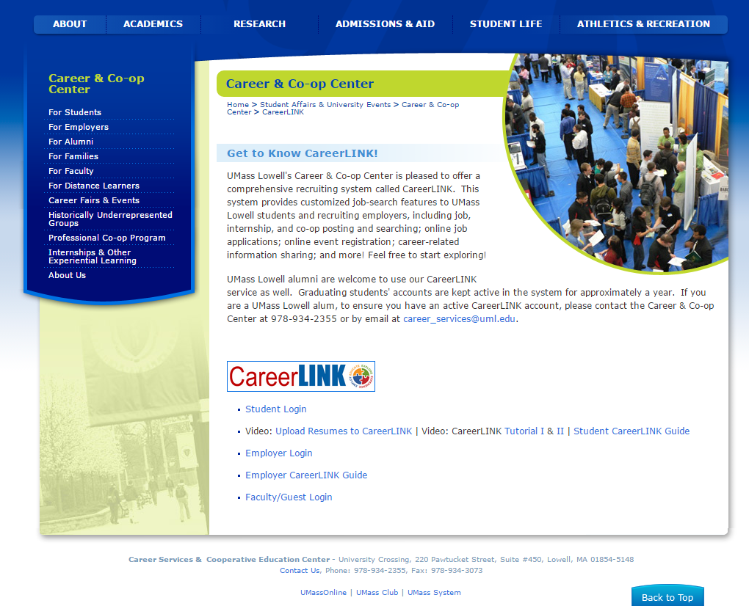
http://career.uml.edu – click on CareerLINK (note the videos!)
Click on “Student Login”
Click on “Job Search” and then “Advanced Search”

Slide 6


Aggregators will allow you to get search results from:
- websites
- online job boards
- newspapers’ job boards
- blogs
- company employment pages
Set up alerts (as many as you want!) to get notifications
No need to post your resume on either site

Slide 7

Networking
What is networking?
Making connections with people in your field, who may eventually be able to help you find employment
What percentage of jobs are gotten through networking?
Across all occupations, approximately 75-85%!
How do you do it?

Slide 8
Networking
Step by Step
Make a list of connections you already have
Create your “pitch” or 30-second introduction
Contact your connections, set up informational interviews, etc.
Send thank you, and keep in touch!

Slide 9
1. Make a list of connections you already have
Friends, former classmates, professors, neighbors
Alums (you can find many on LinkedIn)
People in your field that you’ve already met at events

Slide 10

Finding connections through LinkedIn – especially alumni
Create a professional profile page, including photo
Customize your LinkedIn invitations to connect
Join relevant groups and contact appropriate members
  Examples:
  -UMass Lowell Alumni-Student Career Connections
  -UMass Lowell Alumni
  -Specialty groups
  Example: UMass Lowell Plastics Engineering Alumni

Slide 11
Create Target List of Companies
Use Google and/or CareerLINK to research companies by industry and location
Explore association websites (ex: www.massbio.org) to find names of member companies
Find “careers” page of each company’s website to locate job listings
Are there companies that do business in your home country?
Keep track of all activity within your target companies

Slide 12
2. Create your 30-second introduction
Modify your introduction according to the situation and whom you’re talking to:
-by email
-by phone
-on LinkedIn
-at a professional event
-at a career fair
-HR person; technical staff

Slide 13
Sample
30 Second Introduction (asking for an informational interview)
My name is _______________________, and a friend of mine, ______________, suggested I get in touch with you. I’ll be graduating in May with a Master’s in _________________ from the University of Massachusetts Lowell, and I have experience in/knowledge of _____________ and ______________.
Right now I’m very interested in learning about the role of the [type of position] at different companies. Would it be possible to meet with you briefly? I will not pressure you about job openings. Instead, I would just like to learn more about your company.

Slide 14
3. Contact your connections, set up informational interviews, etc.
Email potential contact, then call to follow up
Prepare for informational interview (questions, dress, resume)
Length of an informational interview?
Purpose of meeting?
Get business card
Ask for referral!

Slide 15
4. Send thank you, and keep in touch!
Email a thank you message within 24 to 48 hours of meeting
How regularly should you keep in touch? (probably monthly)
How could this lead to a job? (when a job becomes available at your contact’s company, your contact may be able to put in a good word for you)

Slide 16
Other ways to network
Follow employers and industry leaders on Twitter
Meet employers at on-campus and off-campus events
Check the Career & Co-op Center’s weekly emails and our website
Example: http://bos.newco.co/2016-schedule/
Example: https://www.massbio.org/events/listing?eventHost=massbio
Join clubs, groups, and professional associations; go to “meet-ups”
Examples:
-SWE
-IEEE
-AICHE
-ASME
-SPE
-ASCE

Slide 17
Suggestions
Don’t underestimate the importance of talking to people
Give yourself PLENTY of time to conduct a thorough search
Do you have a support system?
Use a variety of resources; don’t rely on just one
Make an appointment with the Career & Co-op Center to review your progress
Try your best to remain positive

Slide 18
How we can help
UMass Lowell Career & Co-op Center
2 locations
Career counseling appointments available (get help with your job search strategy!)
Drop-in resume / cover letter critiques
Networking events / panel presentations / workshops
Practice interviews

Slide 19
Questions & Contact Info
Offices: 450 University Crossing | 105 O’Leary Library
Web: career.uml.edu
Phone: 978-934-2355
Email: career_services@uml.edu
Follow us on Twitter and Instagram: UML_Career_Serv

